Slide 1
Capstone Engagement
Assessment, Analysis, and Hardening of a Vulnerable System

Slide 2
Table of Contents
This document contains the following sections:
01
Network Topology
02
Red Team: Security Assessment
03
Blue Team: Log Analysis and Attack Characterization
Hardening: Proposed Alarms and Mitigation Strategies
04

Slide 3
Network Topology
3

Slide 4
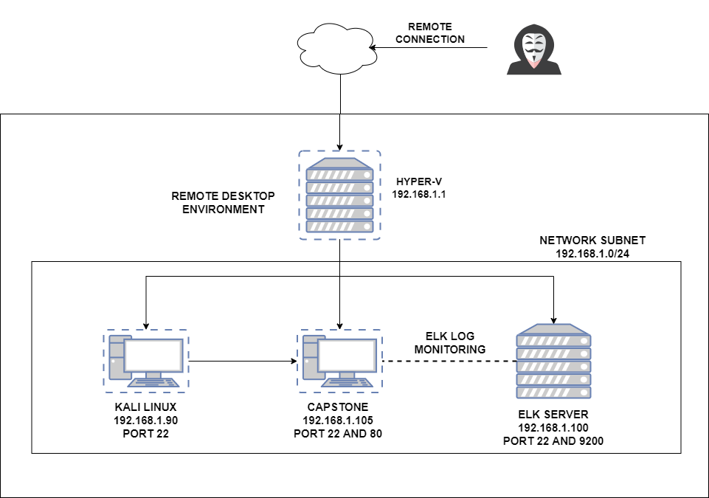
Network Topology
Network
IP Range: 192.168.1.0/24
Netmask: 255.255.255.0
Gateway: 192.168.1.1
Machines
IPv4: 192.168.1.90
OS: Linux
Hostname: Kali
IPv4: 192.168.1.100
OS: Linux
Hostname: ELK
IPv4: 192.168.1.105
OS: Linux
Hostname: Capstone

Slide 5

Red Team
Security Assessment
5

Slide 6
Recon: Describing the Target
Nmap identified the following hosts on the network:
Hostname | IP Address | Role on Network
KALI LINUX (VM) | 192.168.1.90 | ATTACKER
CAPSTONE MACHINE | 192.168.1.105 | TARGET MACHINE
ELK SERVER / KIBANA | 192.168.1.100 | LOG MONITORING AND PARSING

Slide 7
Vulnerability Assessment
The assessment uncovered the following critical vulnerabilities in the target:
Vulnerability | Description | Impact
Senisitve Data Exposure | ‘secret_folder’ is publically accessible, but only meant for authorized personnel. | Attackers can utilize the credentials that can be used to gain access into web servers.
Weak Passwords | Easier for Attackers to Brute force attack passwords. | Will make it very easy for bad attackers to access sensitive areas.
Unauthorized File Upload | Anyone can upload any file to the web server. | Bad actors can upload malicious payloads to execute on server.
Remote Code Execution via Command Injection | Attackers can execute malicious payloads, such as PHP scripts to execute shell commands. | Allows Attackers to create a Reverse shell.

Slide 8
Exploitation: Sensitive Data Exposure
01
02
03
Tools & Processes
Nmap to scan network
‘drib’ to map URLs
Used browser to navigate.
Achievements
Able to find ‘secret_folder’ directory
Directory is password protected but can be brute forced.
Exploitation
Login dialog box reveals the approved user should be ‘ashton’
Info is used to brute-force attack to steal data.

Slide 9
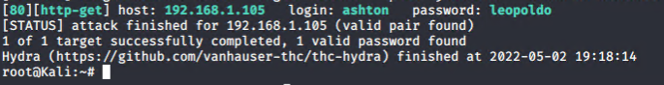
Exploitation: Weak Passwords (Brute Force Attack)
01
02
03
Tools & Processes
Exploration on browser
Hydra (Brute Attack)
Achievements
Gained access using Brute Force attack to find a step-by-step guide on how to remotely connect to web server.
Screenshot
Below

Slide 10
Exploitation: Unauthorized File Upload
01
02
03
Tools & Processes
Cracked user hash to gain access.
Created Web shell in msfconsole
Uploaded Shell.PHP via WebDAV
Achievements
Allows execution of shell commands on target machine.
Exploitation
Utilizing shell commands allows Meterprerter to establish a full connection to the target machine.

Slide 11
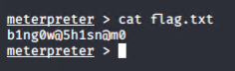
Exploitation: Remote Code Execution via Command Injection
01
02
03
Tools & Processes
Utilized Meterpreter to connect to web shell
Used shell to explore and compromise target machine
Achievements
With Remote code execution, it allowed us to open a Meterpreter shell to target machine
Achieved full file system access for exploration.
Aftermath
Having full access to all files after achieving a shell on target machine, we were able to capture the flag.

Slide 12

Blue Team
Log Analysis and Attack Characterization
12

Slide 13
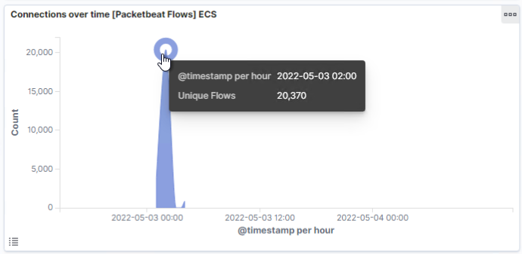
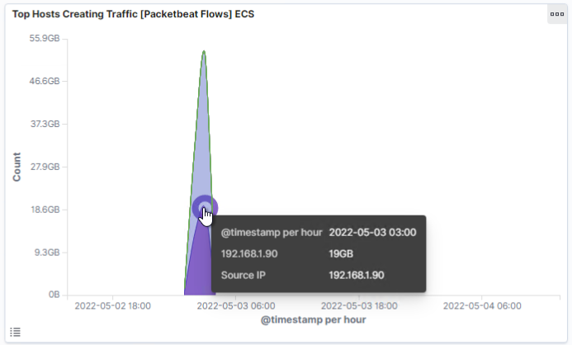
Analysis: Identifying the Port Scan
What time did the port scan occur?
02:00
How many packets were sent, and from which IP?
On the top graph we see a total count of 20,370 and on the second graph we see a lot of traffic from IP address 192.168.1.90
What indicates that this was a port scan?
The last graph shows the responses 401 (unauthorized), 200 (OK), 204 (no content) and 301 (moved permanently).

Slide 14
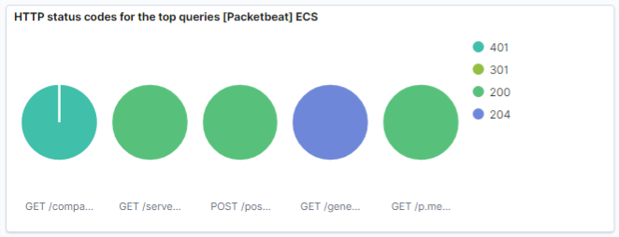
Analysis: Identifying the Port Scan (cont.)

Slide 15
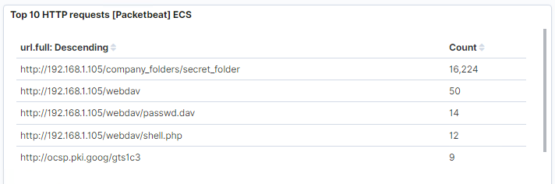
Analysis: Finding the Request for the Hidden Directory
What time did the request occur? How many requests were made?
The first screenshot shows that 20,370 requests were made at 02:00.
Which files were requested? What did they contain?
Notable requests are:
http://192.168.1.105/company_folders/secret_folder
http://192.168.1.105/webdav
http://192.168.1.105/webdav/passwd.dav
http://192.168.1.105/webdav/shell.php

Slide 16
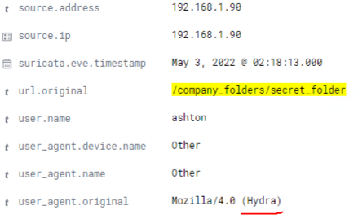

Analysis: Uncovering the Brute Force Attack
With a large number of requests for the ‘/company_folders/secret_folder’, which contains sensitive information, only 2 requests were successful. We also found Hydra, Brute-Force Attack tool, was used as indicated above. These are clear signs of a Brute-Force Attack.
The attacker had attempted 16,224 attempts to gain access into the ‘secret_folder’. Only 2 requests were successful.

Slide 17
Analysis: Finding the WebDAV Connection
The ‘secret_folder’ directory was requested 16,224 times.
The ‘shell.php’ file was requested 12 times.

Slide 18
Blue Team
Proposed Alarms and Mitigation Strategies
18

Slide 19
Mitigation: Blocking the Port Scan
Having a port scan alert, with a threshold of 10 per second and persisting longer than 5 seconds.
These alerts would be also for any use of Nmap being used outside of the company.
Recommendations:
A whitelist of approved IPs and have a firewall in place to block unauthorized IPs from scanning the network.
Use in-house port scanning to identify open or unused ports.

Slide 20
Mitigation: Finding the Request for the Hidden Directory
Set alarm to trigger if IP address not on the whitelist attempt to connect.
Threshold would be True/False alarm.
If requesting IP address is on the whitelist, then no alarm
Conversely, if the IP address is not on the authorized list, alarm triggers.
Recommendations:
Access to sensitive files should only be with specific admin users.
Even when authorized personnel do access sensitive files, a notification lets the other admin users aware.
Encrypt files when at rest.

Slide 21
Mitigation: Preventing Brute Force Attacks
An alarm of 100 requests per second for 5 seconds should trigger notifying the appropriate staff.
Recommendations:
Configure ‘fail2ban’ utility
Utilize more complex passwords that are changed on a routine interval
Stagger timeouts for un-successful login attempts
Multi-Factor Authentication

Slide 22
Mitigation: Detecting the WebDAV Connection
Alarm that fires when the Webdav is access to appropriate staff.
While also only allowing only approved IP addresses
Recommendation:
Install and configure filebeat on host.
This would allow team to monitor access to directory and the requests made.

Slide 23
Mitigation: Identifying Reverse Shell Uploads
Alarm set when a POST request has been made or prohibited file types such as ‘.php’
Alarm should trigger immediately if condition has been met.
Recommendations:
Install and configure Filebeat
Isolate uploads to a storage partition
Scan files before upload.
Firewall to prevent un-authorized IPs from uploading

